Slide 1

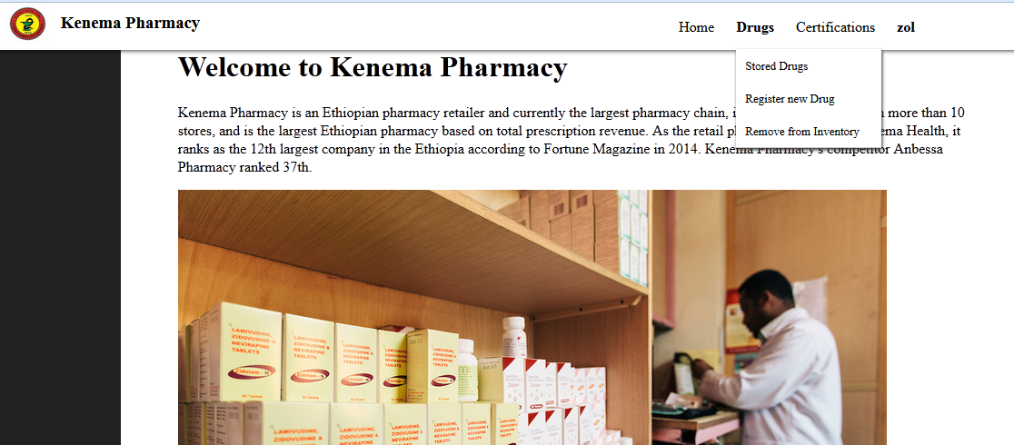
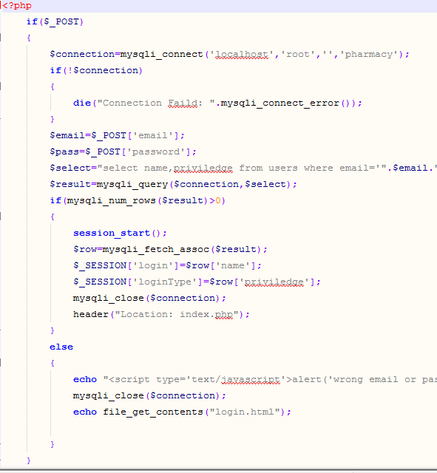
Lab Outline
Introduction to Web & HTML……… part 1 (2 lab)
CSS……………………………………… part 2 (2lab)
JavaScript……………………………… part 3 (3 lab)
Server Side Programming(PHP)…. Part 4 (2 lab)
Project :-web based system!
Mid Lab Test-Create a web site

Slide 2



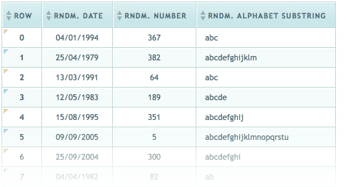
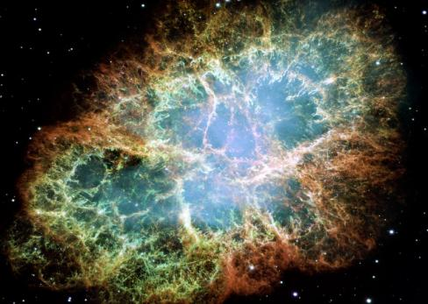
Lab Part 1 Introduction to HTML

Slide 3
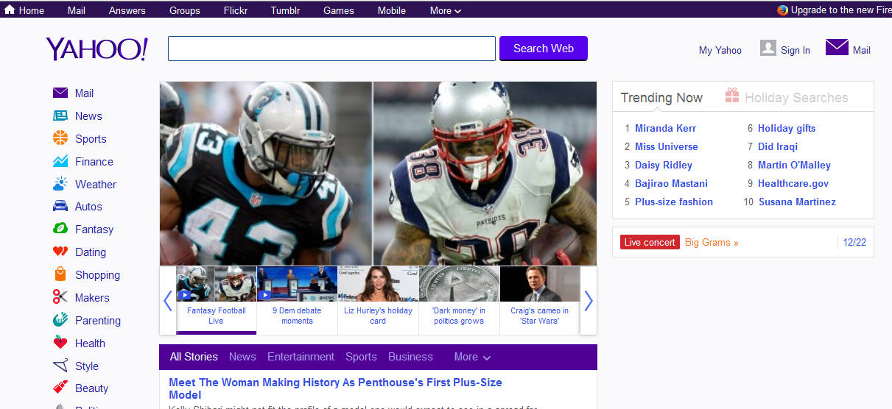
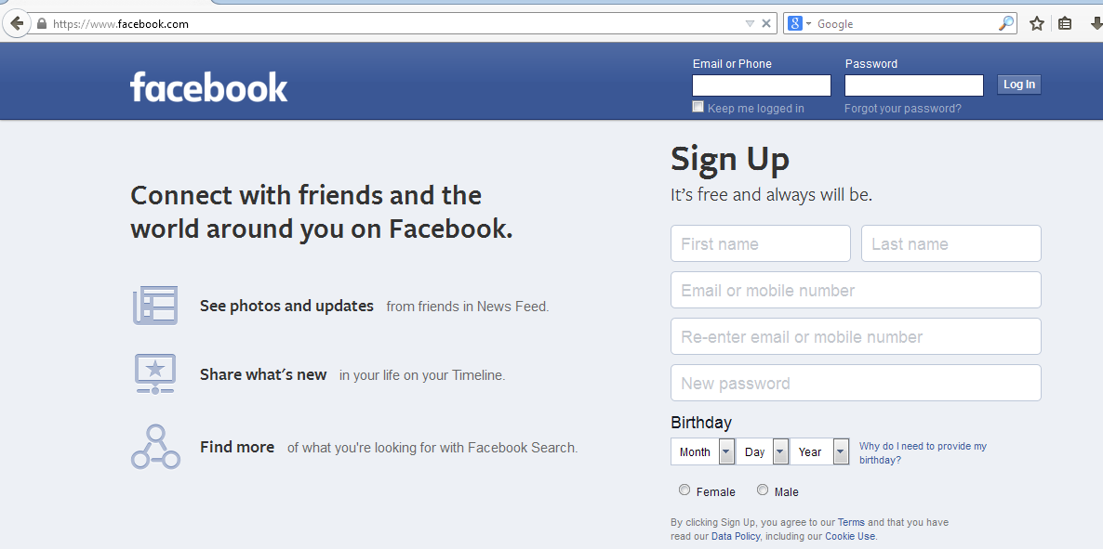
What is HTML?
HTML is a language for describing web pages.
Web is a complex system of interconnected elements.
Web page is a web document that is suitable for the world wide web and web browser.
Web browser displays a web page on monitor or mobile device.

Slide 4
What is HTML?
HTML stands for Hyper Text Markup Language
HTML is not a programming language, it is a markup language
A markup language is a set of markup tags
HTML uses markup tags to describe web pages

Slide 5
HTML Tags
HTML markup tags are usually called HTML tags
HTML tags are keywords surrounded by angle brackets like <html>
HTML tags normally come in pairs like <b> and </b>
The first tag in a pair is the start tag, the second tag is the end tag
Start and end tags are also called opening tags and closing tags

Slide 6
HTML Documents = Web Pages
HTML documents describe web pages
HTML documents contain HTML tags and plain text
HTML documents are also called web pages
The purpose of a web browser (like Internet Explorer or Firefox) is to read HTML documents and display them as web pages. The browser does not display the HTML tags, but uses the tags to interpret the content of the page:

Slide 7
Choosing Text Editor
There are many different programs that you can use to create web documents.
HTML Editors enable users to create documents quickly and easily by pushing a few buttons. Instead of entering all of the HTML codes by hand.
These programs will generate the HTML Source Code for you.
HTML Editors are excellent tools for experienced web developers; however; it is important that you learn and understand the HTML language so that you can edit code and fix “bugs” in your pages.
!!!!!!For this Course, we will use NotePad++.

Slide 8
Creating HTML Pages
An HTML file must have an .htm or .html file extension
HTML files can be created with text editors:
NotePad, NotePad ++, PSPad
Or HTML editors (WYSIWYG Editors):
Microsoft FrontPage
Macromedia Dreamweaver
Netscape Composer
Microsoft Word
Visual Studio

Slide 9
Cont…
Follow the 4 steps below to create your first web page with Notepad.
Open notepad++
2. Write Some HTML
3. Save the HTML Page
Name the file "index.htm" or any other name ending with htm.
4. View HTML Page in Your Browser

Slide 10
HTML Structure
HTML is comprised of “elements” and “tags”
Begins with <html> and ends with </html>
Elements (tags) are nested one inside another:
Tags have attributes:
HTML describes structure using two main sections: <head> and <body>
<html> <head></head> <body></body> </html>
<img src="logo.jpg" alt="logo" />

Slide 11
HTML Code Formatting
The HTML source code should be formatted to increase readability and facilitate debugging.
Every block element should start on a new line.
Every nested (block) element should be indented.
Browsers ignore multiple whitespaces in the page source, so formatting is harmless.
For performance reasons, formatting can be sacrificed

Slide 12
Cont…
HTML Example
<!DOCTYPE html> <html> <head> <title>Page Title</title> </head> <body> <h1>My First Heading</h1> <p>My first paragraph.</p> </body> </html>

Slide 13
Cont…
Example Explained
The DOCTYPE declaration defines the document type to be HTML
The text between <html> and </html> describes an HTML document
The text between <head> and </head> provides information about the document
The text between <title> and </title> provides a title for the document

Slide 14
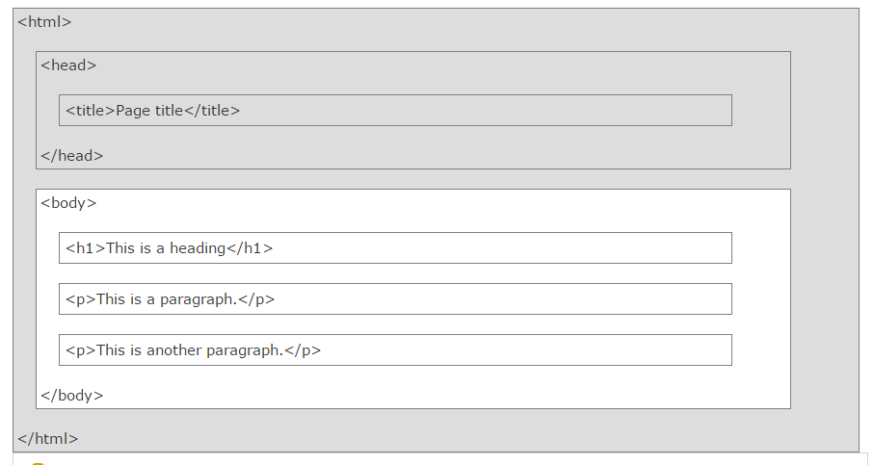
HTML Page Structure

Slide 15
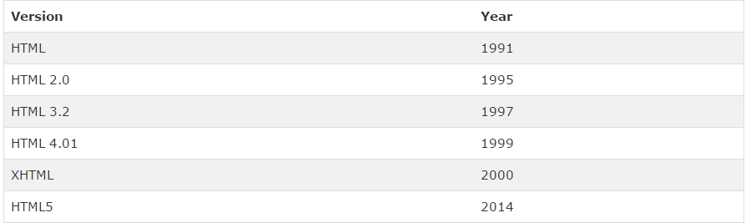
HTML Versions

Slide 16
HTML Elements
HTML documents are defined by HTML elements.
An HTML element is everything from the start tag to the end tag:
<tagname>content</tagname>
The start tag is often called the opening tag. The end tag is often called the closing tag.
Ex:-
The element content is everything between the start and the end tag
Some HTML elements have empty content Empty elements are closed in the start tag
Most HTML elements can have attributes
<p>…….</p>

Slide 17
HTML Elements
<html> <body> <p>This is my first paragraph.</p> </body> </html>
The example above contains how many elements?

Slide 18
HTML Elements
Don't Forget the End Tag
Some HTML elements might display correctly even if you forget the end tag:
The example above works in most browsers, because the closing tag is considered optional.
Never rely on this. Many HTML elements will produce unexpected results and/or errors if you forget the end tag .
<p>This is a paragraph <p>This is a paragraph

Slide 19
Empty HTML Elements
HTML elements with no content are called empty elements.
<br> is an empty element without a closing tag (the <br> tag defines a line break).
HTML Tip: Use Lowercase Tags
HTML tags are not case sensitive: <P> means the same as <p>.

Slide 20
HTML Attributes
HTML elements can have attributes
Attributes provide additional information about an element
Attributes are always specified in the start tag
Attributes come in name/value pairs like: name="value“
Ex:- align is the attribute in p(paragraph) element!!!!!
Always Quote Attribute Values
Attribute values should always be enclosed in quotes.
Double style quotes are the most common, but single style quotes are also allowed.
<p align="left" >am in lab 4!!!</p>

Slide 21
So from now on we will learn about important HTML elements with their attributes!!!!!

Slide 22
The HTML <head> Element
The HTML <head> element has nothing to do with HTML headings.
The HTML <head> element contains meta data. Meta data are not displayed.
The HTML <head> element is placed between the <html> tag and the <body> tag:
Meta Elements
The HTML <style> element is used to define internal CSS style sheets.
The HTML <link> element is used to define external CSS style sheets.

Slide 23
The Body Element
The BODY element of a web page is an important element in regards to the page’s appearance. Here are the attributes of the BODY tag to control all the levels:
TEXT=“yellow" to change the color of all the text on the page (full page text color.)
Bgcolor=“blue” to change the back ground color.
Background=“hi.jpg”
!!!!!This element contains attributes about the page’s background color, the background image, as well as the text colors.

Slide 24
Exercise
Add an image background to the following html script with a red text color?
<html>
<head><title>background</title></head>
<body>
<p>hi there!!!!!</p>
</body>
</html>

Slide 25
Solution
<html>
<head><title>background</title></head>
<body background=“tt.jpg” text=“red”>
<p>hi there!!!!!</p>
</body>
</html>

Slide 26

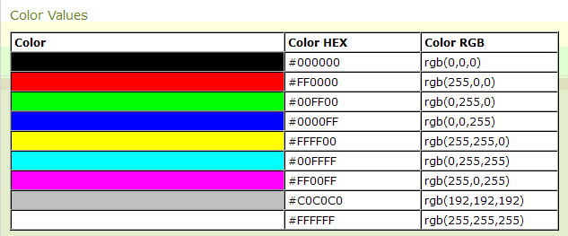
HTML Colors
Colors are displayed combining RED, GREEN, and BLUE light.
HTML colors are defined using a hexadecimal notation (HEX) for the combination of Red, Green, and Blue color values (RGB).
The lowest value that can be given to one of the light sources is 0 (in HEX: 00). The highest value is 255 (in HEX: FF).
HEX values are specified as 3 pairs of two-digit numbers, starting with a # sign.

Slide 27
RGB (Red, Green, Blue)
With HTML, RGB color values can be specified using this formula: rgb(red, green, blue)
Each parameter (red, green, and blue) defines the intensity of the color between 0 and 255.
For example, rgb(255,0,0) is displayed as red, because red is set to its highest value (255) and the others are set to 0. Experiment by mixing the RGB values below:

Slide 28
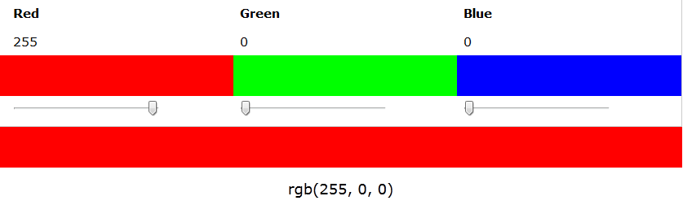
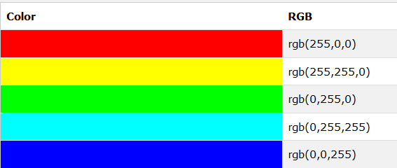
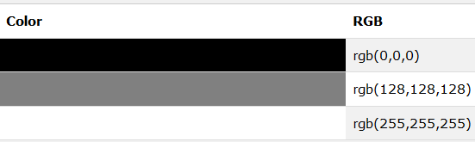
RGB (Red, Green, Blue)

Slide 29
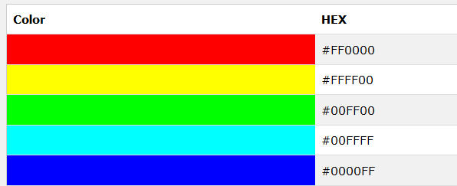
Hexadecimal Colors
With HTML, RGB values can also be specified using hexadecimal color values in the form: #RRGGBB, where RR (red), GG (green) and BB (blue) are hexadecimal values between 00 and FF (same as decimal 0-255).
For example, #FF0000 is displayed as red, because red is set to its highest value (FF) and the others are set to the lowest value (00).

Slide 30
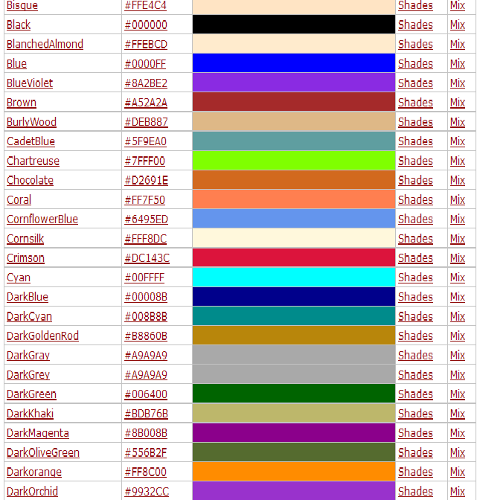
CSS supports 140 standard color names.256 x 256).
http://www.vgdesign.com/color.html

Slide 31
Exercise
Use The color codes to change the background of the script below?
<html>
<head><title>background</title></head>
<body >
<p>hi there!!!!!</p>
</body>
</html>

Slide 32
HTML Headings
Headings are important in HTML documents.
Headings are defined with the <h1> to <h6> tags.
<h1> defines the most important heading. <h6> defines the least important heading.
Use HTML headings for headings only. Don't use headings to make text BIG or bold.
<html>
<head><title>headings</title></head>
<body>
<h1>This is a heading</h1> <h2>This is a heading</h2> <h3>This is a heading</h3>
</body>
</html>

Slide 33

Example of use of Heading

Slide 34
Exercise
Add a heading 1 to the paragraph with the text "London".
Write an HTML script that displays the following?
<html>
<body>
<p>London is the capital city of England. It is the most populous city in the United Kingdom, with a metropolitan area of over 13 million inhabitants.</p>
</body>
</html>
Heading 1
Heading 2
Heading 3
Heading 4
Heading 5
Heading 6

Slide 35
Solution
<html>
<body>
<h1>London</h1>
<p>London is the capital city of England. It is the most populous city in the United Kingdom, with a metropolitan area of over 13 million inhabitants.</p>
</body>
</html>
<HTML>
<HEAD>
<TITLE> Example Page</TITLE>
</HEAD>
<BODY>
<H1> Heading 1 </H1>
<H2> Heading 2 </H2>
<H3> Heading 3 </H3>
<H4> Heading 4 </H4>
<H5> Heading 5 </H5>
<H6> Heading 6 </H6>
</BODY>
</HTML>

Slide 36
Exercise
Mark up the following text with appropriate tags: "Universal Studios" is the most important content. "Jurassic Park" is the next most important content. "About" is of lesser importance than Jurassic Park. “Help” is just a paragraph.

Slide 37
Solution
<html>
<body>
<h1>Universal Studios Presents</h1>
<h2>Jurassic Park</h2>
<h3>About</h3>
<p>Help</p>
</body>
</html>

Slide 38
Paragraphs, <P> </P>
Paragraphs allow you to add text to a document in such a way that it will automatically adjust the end of line to suite the window size of the browser in which it is being displayed. Each line of text will stretch the entire length of the window.
Heading 1
Paragraph 1,….
Heading 2
Paragraph 2,….
Heading 3
Paragraph 3,….
Heading 4
Paragraph 4,….
Heading 5
Paragraph 5,….
Heading 6
Paragraph 6,….
<HTML><HEAD>
<TITLE> Example Page</TITLE>
</HEAD>
<BODY></H1> Heading 1 </H1>
<P> Paragraph 1, ….</P>
<H2> Heading 2 </H2>
<P> Paragraph 2, ….</P>
<H3> Heading 3 </H3>
<P> Paragraph 3, ….</P>
<H4> Heading 4 </H4>
<P> Paragraph 4, ….</P>
<H5> Heading 5 </H5>
<P> Paragraph 5, ….</P>
<H6> Heading 6</H6>
<P> Paragraph 6, ….</P>
</BODY></HTML>

Slide 39
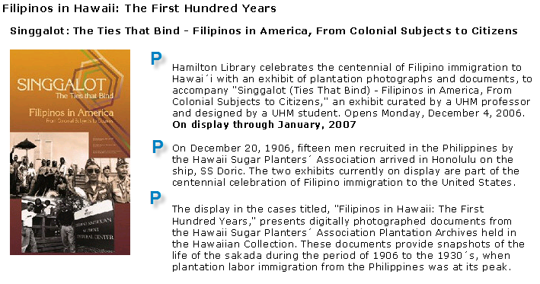
Paragraph example

Slide 40
Break, <BR>
Line breaks allow you to decide where the text will break on a line or continue to the end of the window.
A <BR> is an empty Element, meaning that it may contain attributes but it does not contain content.
!!!!!The <BR> element does not have a closing tag.
<HTML>
<HEAD>
<TITLE> Example Page</TITLE>
</HEAD>
<BODY>
<H1> Heading 1 </H1>
<P>Paragraph 1, <BR>
Line 2 <BR> Line 3 <BR>….
</P>
</BODY>
</HTML>
Heading 1
Paragraph 1,….
Line 2
Line 3
….

Slide 41
Exercise
Fix the display of the poem below. Display the poem over 4 lines.
<html>
<body>
<p>
My Bonnie lies over the ocean.
My Bonnie lies over the sea.
My Bonnie lies over the ocean.
Oh, bring back my Bonnie to me.
</p>
</body>
</html>

Slide 42
Solution
<html>
<body>
<p>
My Bonnie lies over the ocean.<br>
My Bonnie lies over the sea.<br>
My Bonnie lies over the ocean.<br>
Oh, bring back my Bonnie to me.
</p>
</body>
</html>

Slide 43
Horizontal Rule, <HR>
The <HR> element causes the browser to display a horizontal line (rule) in your document.
!!!!!!!<HR> does not use a closing tag, </HR>.
<HTML>
<HEAD>
<TITLE> Example Page</TITLE>
</HEAD>
<BODY>
<H1> Heading 1 </H1>
<P>Paragraph 1, <BR>
Line 2 <BR>
<HR>Line 3 <BR>
</P>
</BODY>
</HTML>
Heading 1
Paragraph 1,
Line 2
___________________________
Line 3

Slide 44
Horizontal Rule, <HR>
Attribute | Description | Default Value
SIZE | Height of the rule in pixels | 2 pixels
WIDTH | Width of the rule in pixels or percentage of screen width | 100%
ALIGN | Aligns the line (Left, Center, Right) | Center
COLOR | Sets a color for the rule (IE 3.0 or later) | Not set

Slide 45
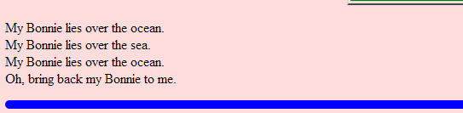
Exercise
Add blue horizontal line at the end of the poem you created earlier.
align="left" size="10" color="blue" width="50%"
<html>
<body>
<p>
My Bonnie lies over the ocean.<br>
My Bonnie lies over the sea.<br>
My Bonnie lies over the ocean.<br>
Oh, bring back my Bonnie to me.
</p>
</body>
</html>

Slide 46
solution
<p>
My Bonnie lies over the ocean.<br>
My Bonnie lies over the sea.<br>
My Bonnie lies over the ocean.<br>
Oh, bring back my Bonnie to me.
</p>
<hr align="left" size="10" color="blue" width="50%">

Slide 47
HTML Formatting Elements
HTML uses elements like <b> and <i> for formatting output, like bold or italic text.
Formatting elements were designed to display special types of text:
Bold text
Important text
Italic text
Emphasized text
Marked text
Strong

Slide 48
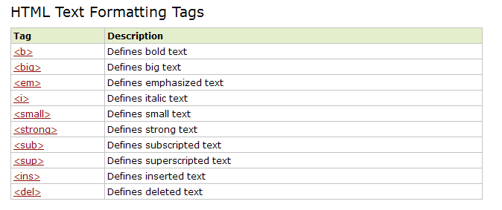
HTML Formatting Elements

Slide 49
Cont…
Browsers display <strong> as <b>, and <em> as <i>.
However, there is a difference in the meaning of these tags: <b> and <i> defines bold and italic text
but <strong> and <em> means that the text is "important".

Slide 50
Cont…
The HTML <del> element defines deleted (removed) of text.
The HTML <sub> element defines subscripted text
The HTML <sup> element defines superscripted text.

Slide 51
Exercise
Add extra importance to the word "degradation" in the paragraph below?
.
<html>
<body>
<h1>What Does WWF Do?</h1>
<p>WWF's mission is to stop the degradation of our planet's natural environment.</p>
</body>
</html>

Slide 52
Solution
<html>
<body>
<h1>What Does WWF Do?</h1>
<p>WWF's mission is to stop the <strong>degradation</strong> of our planet's natural environment.</p>
</body>
</html>

Slide 53
Exercise
Emphasize the word "metropolitan" in the text below.
<html>
<body>
<h1>Tokyo</h1>
<p>Tokyo is the capital of Japan, the center of the Greater Tokyo Area, and the most populous metropolitan area in the world.</p>
</body>
</html>

Slide 54
Solution
<html>
<body>
<h1>Tokyo</h1>
<p>Tokyo is the capital of Japan, the center of the Greater Tokyo Area, and the most populous <em>metropolitan</em> area in the world.</p>
</body>
</html>

Slide 55
Exercise
Apply subscript formatting to the number "2" in the text below.
<html>
<body>
<p>H2O is the scientific term for water.</p>
</body>
</html>

Slide 56
Solution
<html>
<body>
<p>H<sub>2</sub>O is the scientific term for water.</p>
</body>
</html>

Slide 57
Exercise
Add a line through (strikeout) the letters "blue" in the text below
<html>
<body>
<p>My favorite color is blue red.</p>
</body>
</html>

Slide 58
Solution
<html>
<body>
<p>My favorite color is <del>blue</del> red.</p>
</body>
</html>

Slide 59
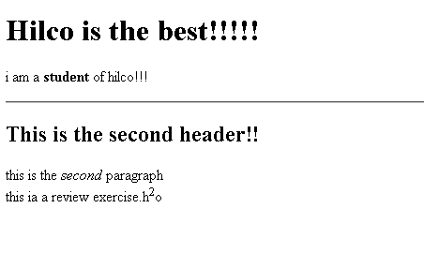
Review exercise

Slide 60
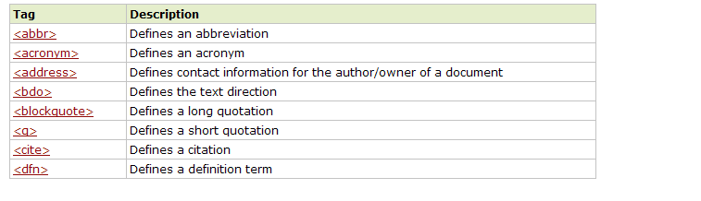
HTML Citations, Quotations, and Definition Tags

Slide 61
Exercise
Use an HTML element to add quotation marks around the letters "cool“
<html>
<body>
<p>I am so cool.</p>
</body>
</html>

Slide 62
Solution
<html>
<body>
<p>I am so <q>cool</q>.</p>
</body>
</html>

Slide 63
Exercise
The letters "WHO" in the text below is an abbreviation of "World Health Organization". Use an HTML element to provide the specified abbreviation of "WHO".
<html>
<body>
<p>The WHO was founded in 1948.</p>
</body>
</html>

Slide 64
Solution
<html>
<body>
<p>The <abbr title="World Health Organization">WHO</abbr> was founded in 1948.</p>
</body>
</html>

Slide 65
HTML Special Characters
Symbol Name
HTML Entity
Symbol
Copyright Sign
&copy;
©
Registered Trademark Sign
&reg;
®
Trademark Sign
&trade;
™
Less Than
&lt;
<
Greater Than
&gt;
>
Ampersand
&amp;
&
Non-breaking Space
&nbsp;
Em Dash
&mdash;
—
Quotation Mark
&quot;
"
Euro
&#8364;
€
British Pound
&pound;
£
Japanese Yen
&yen;
¥
65

Slide 66
HTML Comments: <!-- --> Tag
Comments can exist anywhere between the tags
Comments start with <!-- and end with -->
<!–- Telerik Logo (a JPG file) -->
<img src="logo.jpg" alt=“Telerik Logo">
<!–- Hyperlink to the web site -->
<a href="http://telerik.com/">Telerik</a>
<!–- Show the news table -->
<table class="newstable">
...

Slide 67
Alignment
Some elements have attributes for alignment (ALIGN) e.g. Headings, Paragraphs and Horizontal Rules.
The Three alignment values are : LEFT, RIGHT, CENTER.
<CENTER></CENTER> Will center elements.
ex:-<p align=“left>hi there</p>

Slide 68
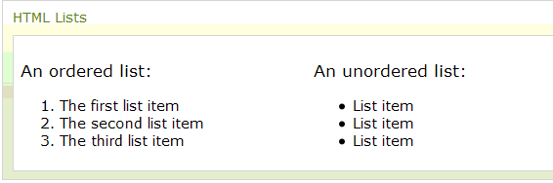
HTML Lists
The most common HTML lists are ordered and unordered lists:

Slide 69
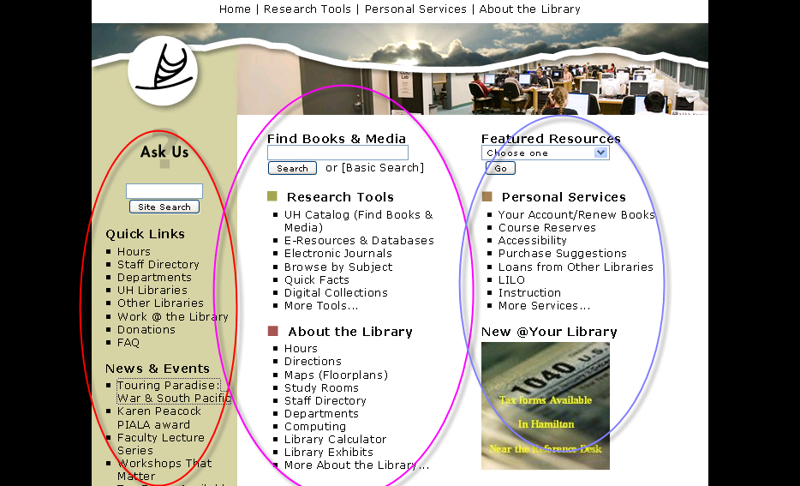
use of Links

Slide 70
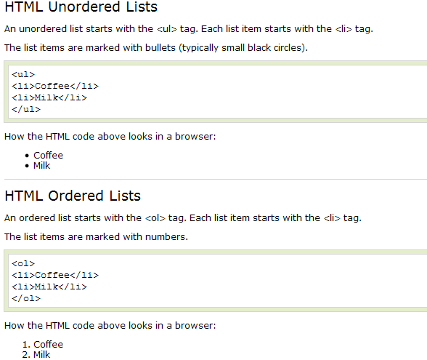
Html lists

Slide 71
Exercise
Add a list item with the text "Coffee, tea, milk" inside <ul>
<html>
<body>
<ul>
</ul>
</body>
</html>

Slide 72
Solution
<html>
<body>
<ul>
<li>Coffee</li>
</ul>
</body>
</html>

Slide 73
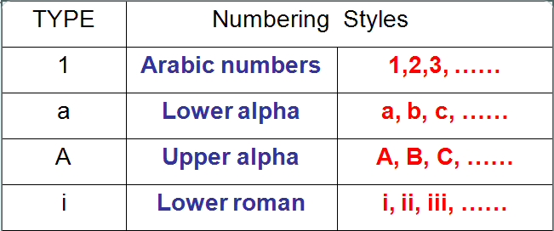
‘Type’ attribute
“TYPE” attribute changes the bullets types.
EX:-<UL TYPE=“square”>
Unordered list has three types : disc(default), circle, square
For ordered list.
.

Slide 74
Exercise
Change the list below to display letters instead of numbers.
<html>
<body>
<ol>
<li>Coffee</li>
<li>Tea</li>
<li>Milk</li>
</ol>
</body>
</html>

Slide 75
Solution
<html>
<body>
<ol type="A">
<li>Coffee</li>
<li>Tea</li>
<li>Milk</li>
</ol>
</body>
</html>

Slide 76
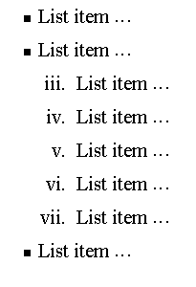
Nesting Lists
You can nest lists by inserting a UL, OL, etc., inside a list item (LI).
EXample
<UL TYPE = “square”>
<LI> List item …</LI>
<LI> List item …
<OL TYPE=“i” START=“3”>
<LI> List item …</LI>
<LI> List item …</LI>
<LI> List item …</LI>
<LI> List item …</LI>
<LI> List item …</LI>
</OL>
</LI>
<LI> List item …</LI>
</UL>

Slide 77
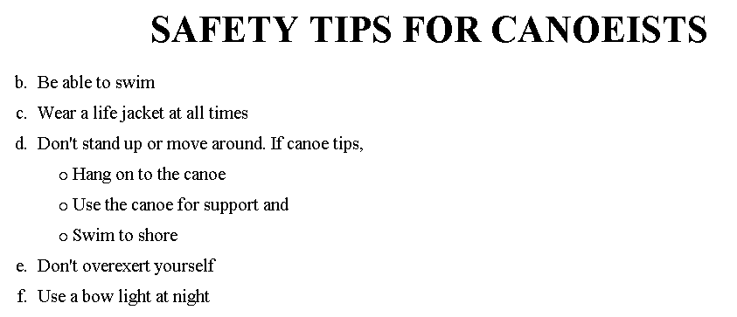
Exercise

Slide 78
Solution
<H1 ALIGN="CENTER">SAFETY TIPS FOR CANOEISTS</H1> <OL TYPE=“a” START=“2”> <LI>Be able to swim </LI> <LI>Wear a life jacket at all times </LI> <LI>Don't stand up or move around. If canoe tips,
<UL> <LI>Hang on to the canoe </LI> <LI>Use the canoe for support and </LI> <LI>Swim to shore </UL> </LI>
<LI>Don't overexert yourself </LI> <LI>Use a bow light at night </LI> </OL>

Slide 79
Solution
<ol type="1">
<li>Apple</li>
<li>Orange</li>
<li>Grapefruit</li>
</ol>
<ul type="disc">
<li>Apple</li>
<li>Orange</li>
<li>Grapefruit</li>
</ul>
<dl>
<dt>HTML</dt>
<dd>A markup lang…</dd>
</dl>

Slide 80
Image
<IMG>This element defines a graphic image on the page.
Image File (SRC:source): This value will be a URL (location of the image) E.g. http://www.domain.com/dir/file.ext or /dir/file.txt.
Alternate Text (ALT): This is a text field that describes an image or acts as a label. It is displayed when they position the cursor over a graphic image.
Alignment (ALIGN): This allows you to align the image on your page.
Width (WIDTH): is the width of the image in pixels.
Height (HEIGHT): is the height of the image in pixels.
Border (BORDER): is for a border around the image, specified in pixels.

Slide 81
Exercise
Double the size of the image below.
<html>
<body>
<img src="programming.gif" alt="Computer Man"
width="48" height="48">
</body>
</html>

Slide 82
Solution
<html>
<body>
<img src="programming.gif" alt="Computer Man"
width="96" height="96">
</body>
</html>

Slide 83
Html Tables
The <TABLE></TABLE> element has four sub-elements:
Table Row<TR></TR>.
Table Header <TH></TH>.
Table Data <TD></TD>.
Caption <CAPTION></CAPTION>.
The table row elements usually contain table header elements or table data elements.

Slide 84
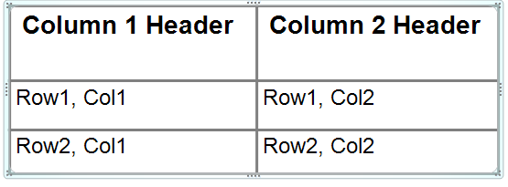
Html Tables
<table border=“1”>
<tr>
<th> Column 1 header </th>
<th> Column 2 header </th>
</tr>
<tr>
<td> Row1, Col1 </td>
<td> Row1, Col2 </td>
</tr>
<tr>
<td> Row2, Col1 </td>
<td> Row2, Col2 </td>
</tr>
</table>

Slide 85
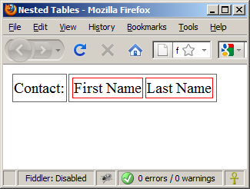
Nested Tables
Table data “cells” (<td>) can contain nested tables (tables within tables):
nested-tables.html
<table>
<tr>
<td>Contact:</td>
<td>
<table>
<tr>
<td>First Name</td>
<td>Last Name</td>
</tr>
</table>
</td>
</tr>
</table>

Slide 86
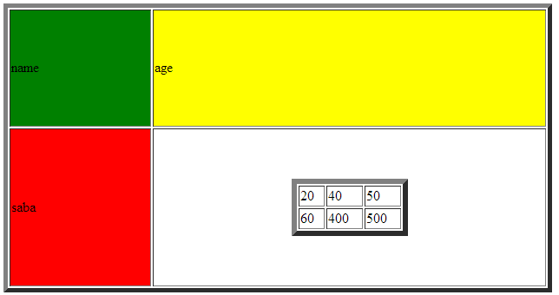
Exercises
Create the following table?

Slide 87
Solution
<html>
<body>
<table border="5" width="50%" height="50%">
<tr>
<td bgcolor="green" >
name
</td>
<td bgcolor="yellow">
age
</td>
</tr>
<tr>
<td bgcolor="red">
saba
</td>
<td>
<table border="6" width="30%" align="center"><tr><td>20</td><td>40</td><td>50</td></tr><tr><td>60</td><td>400</td><td>500</td></tr></table>
</td>
</tr>
</table>
</body>
</html>

Slide 88
Table Attributes
BGColor: Some browsers support background colors in a table.
Width: you can specify the table width as an absolute number of pixels or a percentage of the document width. You can set the width for the table cells as well.
Border: You can choose a numerical value for the border width, which specifies the border in pixels.
CellSpacing: Cell Spacing represents the space between cells and is specified in pixels

Slide 89
Table Attributes
CellPadding: Cell Padding is the space between the cell border and the cell contents and is specified in pixels.
Align: tables can have left, right, or center alignment.
Background: Background Image, will be titled in IE3.0 and above.
BorderColor,

Slide 90
Cell Spacing and Padding
Tables have two important attributes:
cellspacing
Defines the empty space between cells
cellpadding
Defines the empty space around the cell content
cell
cell
cell
cell
cell
cell
cell
cell

Slide 91
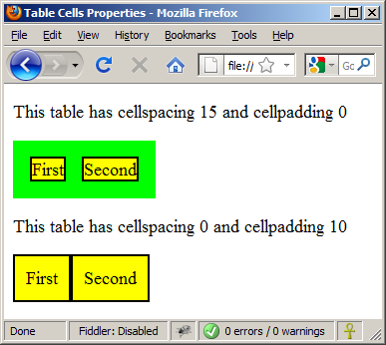
Cell Spacing and Padding – Example (2)
table-cells.html
<html>
<head><title>Table Cells</title></head>
<body>
<table cellspacing="15" cellpadding="0">
<tr><td>First</td>
<td>Second</td></tr>
</table>
<br/>
<table cellspacing="0" cellpadding="10">
<tr><td>First</td><td>Second</td></tr>
</table>
</body>
</html>

Slide 92
Table Caption
A table caption allows you to specify a line of text that will appear centered above or bellow the table.
<TABLE BORDER=1 CELLPADDING=2>
<CAPTION ALIGN=“BOTTOM”> Label For My Table </CAPTION>
The Caption element has one attribute ALIGN that can be either TOP (Above the table) or BOTTOM (below the table).

Slide 93
Table Data and Table Header Attributes
Colspan: Specifies how many cell columns of the table this cell should span.
Rowspan: Specifies how many cell rows of the table this cell should span.
Align: cell data can have left, right, or center alignment.
Valign: cell data can have top, middle, or bottom alignment.
Width: you can specify the width as an absolute number of pixels or a percentage of the document width.
Height: You can specify the height as an absolute number of pixels or a percentage of the document height.

Slide 94
Column and Row Span
Table cells have two important attributes:
colspan
Defines how many columns the cell occupies
rowspan
Defines how many rows the cell occupies
colspan="1"
colspan="1"
rowspan="2"
rowspan="1"
cell[1,1]
cell[1,2]
cell[1,1]
cell[1,2]
cell[2,1]
cell[2,1]
colspan="2"
rowspan="1"

Slide 95
Column and Row Span –
table-colspan-rowspan.html
<table cellspacing="0">
<tr class="1"><td>Cell[1,1]</td>
<td colspan="2">Cell[2,1]</td></tr>
<tr class=“2"><td>Cell[1,2]</td>
<td rowspan="2">Cell[2,2]</td>
<td>Cell[3,2]</td></tr>
<tr class=“3"><td>Cell[1,3]</td>
<td>Cell[2,3]</td></tr>
</table>
Cell[1,1]
Cell[2,1]
Cell[1,2]
Cell[2,2]
Cell[3,2]
Cell[1,3]
Cell[2,3]

Slide 96
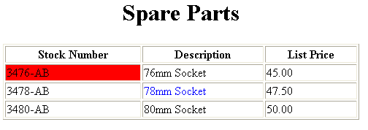
Basic Table Code
<TABLE BORDER=1 width=50%>
<CAPTION> <h1>Spare Parts <h1> </Caption>
<TR>
<TH>Stock Number</TH>
<TH>Description</TH><TH>List Price</TH>
</TR>
<TR>
<TD bgcolor=red>3476-AB</TD>
<TD>76mm Socket</TD>
<TD>45.00</TD>
</TR>
<TR>
<TD >3478-AB</TD>
<TD><font color=blue>78mm Socket</font> </TD>
<TD>47.50</TD>
</TR>
<TR>
<TD>3480-AB</TD>
<TD>80mm Socket</TD>
<TD>50.00</TD>
</TR>
</TABLE>

Slide 97
Exercise
Column 1 Header | Column 2 Header
Row 1 Col 1
Row 2 Col 1 | Row 2 Col 2
 | Row 3 Col 2

Slide 98
Solution
<Table border=1 cellpadding =2>
<tr> <th> Column 1 Header</th> <th> Column 2 Header</th> </tr>
<tr> <td colspan=2> Row 1 Col 1</td> </tr>
<tr> <td rowspan=2>Row 2 Col 1</td>
<td> Row 2 Col2</td> </tr>
<tr> <td> Row 3 Col2</td> </tr>
</table>

Slide 99
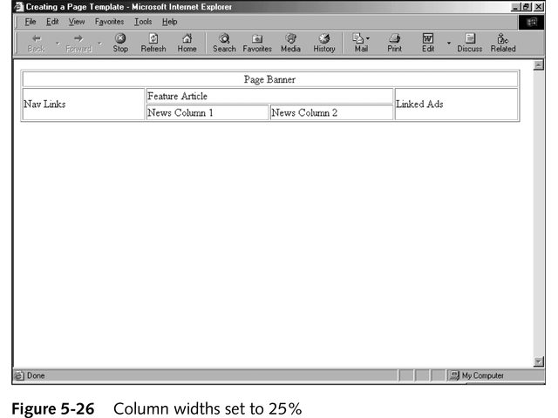
Exersise

Slide 100
Solution
<TABLE BORDER width=“750”>
<TR> <TD colspan=“4” align=“center”>Page Banner</TD></TR>
<TR> <TD rowspan=“2” width=“25%”>Nav Links</TD><TD colspan=“2”>Feature Article</TD> <TD rowspan=“2” width=“25%”>Linked Ads</TD></TR>
<TR><TD width=“25%”>News Column 1 </TD> <TD width=“25%”><News Column 2 </TD></TR>
</TABLE>

Slide 101
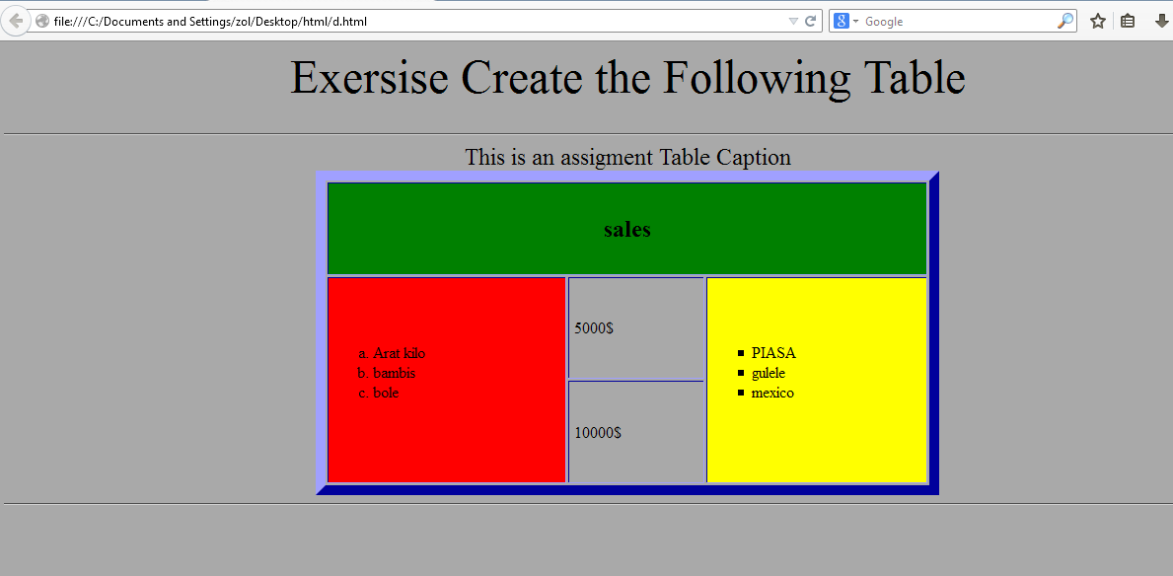

Slide 102
HTML Links
HTML links are hyperlinks.
A hyperlink is a text or an image you can click on, and jump to another document.
In HTML, links are defined with the <a> tag:

Slide 103
Cont…
<a href="url">link text</a>
The href attribute specifies the destination address (http://www.google.com/html/)
The link text is the visible part
The link text does not have to be text. It can be an HTML image or any other HTML element.
Ex:-
<a href=“www.google.com">Click here to go to google home page</a>
<a href="table2.html"><img src="ball.bmp"></a>

Slide 104
Cont…
The target attribute specifies where to open the linked document.
Example
<a href="http://www.google.com/" target="_blank">Visit Google!</a>

Slide 105
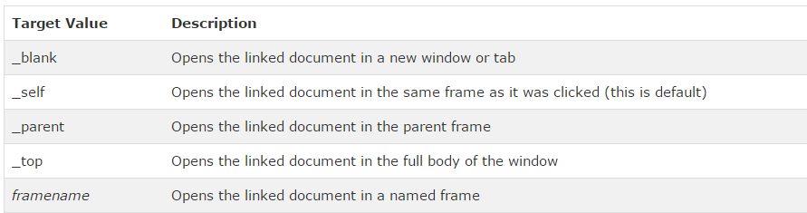
Cont…

Slide 106
Exercise
Create a link that connects to yahoo home page?
Create a link that connects to another page, you created inside your folder?

Slide 107
Solution
<html>
<body>
<a href=“http://www.yahoo.com" >Click here to go to yahoos home page</a>
</body>
</html>
<html>
<body>
<a href=“anotherpage.html" >Click here to go another page</a>
</body>
</html>

Slide 108
Internal Links
Internal Links : Links can also be created inside large documents to simplify navigation. Today’s world wants to be able to get the information quickly. Internal links can help you meet these goals.
Select some text at a place in the document that you would like to create a link to, then add an anchor to link to like this:
<A NAME=“bookmark_name”></A>
The Name attribute of an anchor element specifies a location in the document that we link to shortly. All NAME attributes in a document must be unique.
Next select the text that you would like to create as a link to the location created above.
<A HREF=“#bookmark_name”>Go To Book Mark</A>
Or, create a link to the "Useful Tips Section" from another page:
<a href="http://www.w3schools.com/html_links.htm#tips"> Visit the Useful Tips Section</a>

Slide 109
Exercise
Create a link that will link to the title London?
Create a link from another page that will link to the title london.
<html>
<body>
<h1align=“center”>London</h>
<p>London is the capital city of England. It is the most populous city in the United Kingdom, with a metropolitan area of over 13 million inhabitants.</p>
</body>
</html>

Slide 110
Solution
<html>
<body>
<h1 align=“center”><a name="london">London</a></h1>
<p>London is the capital city of England. It is the most populous city in the United Kingdom,<br> with a metropolitan area of over 13 million inhabitants.</p>
<a href="#london">see about london</a>
</body>
</html>
<a href="table.html#london">Read About london from another page</a>

Slide 111
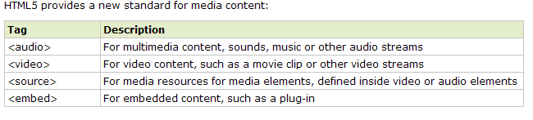
HTML 5 New Media Elements

Slide 112
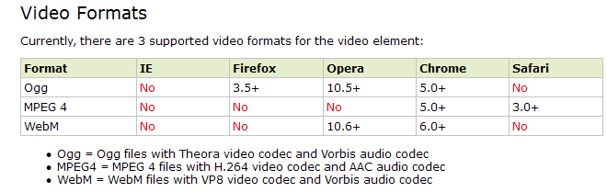
HTML5 Video
Video on the Web
Until now, there has never been a standard for showing video on a web page.
Today, most videos are shown through a plugin (like flash). However, not all browsers have the same plugins.
HTML5 specifies a standard way to include video, with the video element.

Slide 113
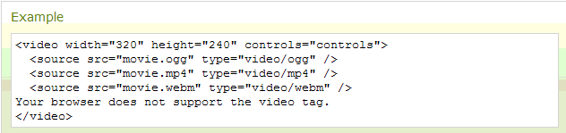
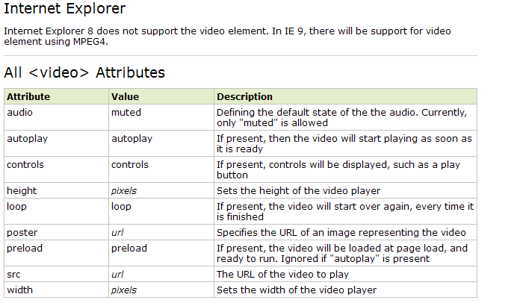
How it Works
The control attribute is for adding play, pause, and volume controls.

Slide 114
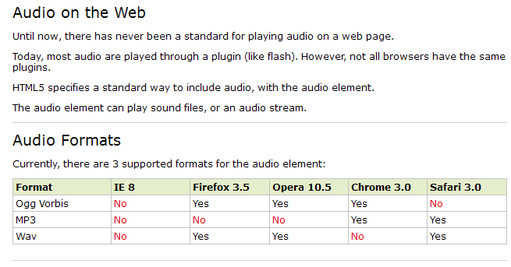
HTML5 Audio
HTML5 provides a standard for playing audio.

Slide 115
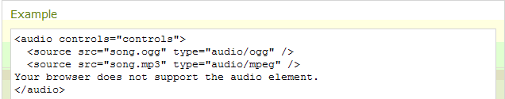
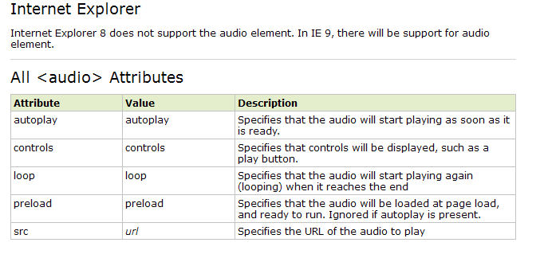
How it Works

Slide 116
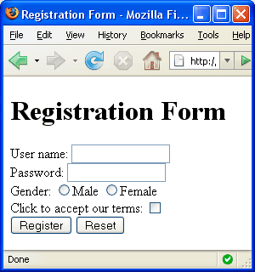


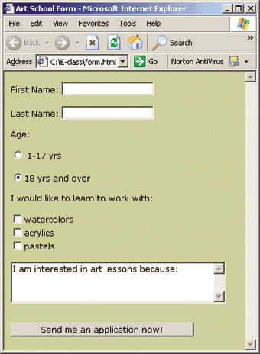
HTML Forms

Slide 117
HTML Forms
Forms are the primary method for gathering data from site visitors
Create a form block with
Example:
The “method" attribute tells how the form data should be sent – via GET or POST request
<form></form>
<form name="myForm" method="post" action="path/to/some-script.php">
...
</form>
The "action" attribute tells where the form data should be sent

Slide 118
HTML Forms - The Input Element
The most important form element is the input element.
The input element is used to select user information.
An input element can vary in many ways, depending on the type attribute. An input element can be of type text field, checkbox, password, radio button, submit button, and more.
The most used input types are described below.

Slide 119
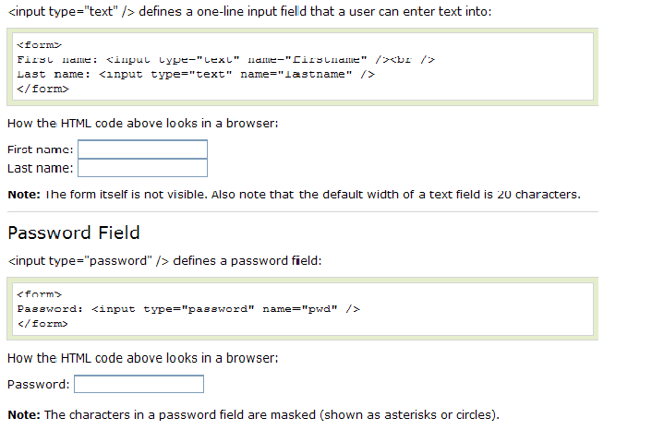
Text Field

Slide 120
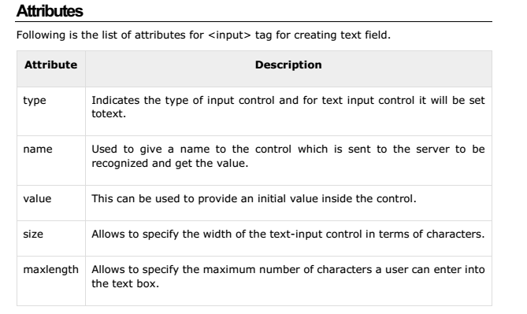
Text Field

Slide 121
Input Type Attributes
Attribute name | use
Disabled | Used to disable an input element
value | Used to give a default value
Readonly | The content of the input element cant be changed
The maxlength Attribute | The maxlength attribute specifies the maximum allowed length for the input field:
autofocus | The autofocus attribute is a boolean attribute.
placeholder | The placeholder attribute specifies a hint that describes the expected value of an input field
required | it specifies that an input field must be filled out before submitting the form.

Slide 122
Exercise
Create the following Text Fields (hint:-use Table, #C52546)

Slide 123
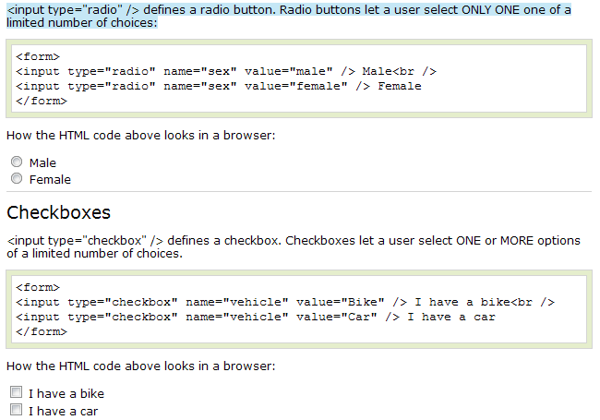
Radio Buttons

Slide 124
Exercise
Create the following List?(use font element for color and size)

Slide 125
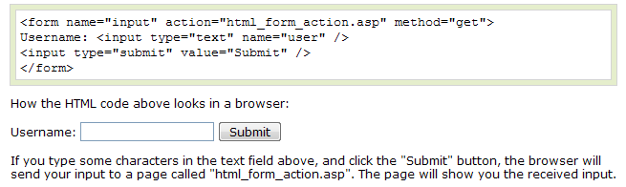
Submit Button
<input type="submit" /> defines a submit button.
A submit button is used to send form data to a server. The data is sent to the page specified in the form's action attribute. The file defined in the action attribute usually does something with the received input:

Slide 126
Other Form Controls
Reset button – brings the form to its initial state
Ordinary button – used for JavaScript, no default action
<input type="reset" name="resetBtn"
value="Reset the form" />
<input type="button" value="click me" />

Slide 127
Exercise
Create the following form Using Tables?

Slide 128
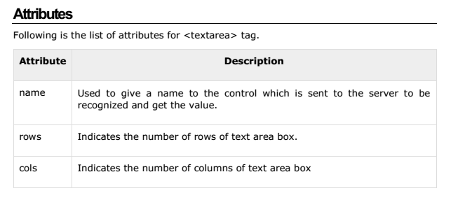
Text Area
This is used when the user is required to give details that may be longer than a single sentence. Multi-line input controls are created using HTML <textarea> tag.

Slide 129
Exercise
Create a text area that will accept comments about the users satisfaction!!!!!!!

Slide 130
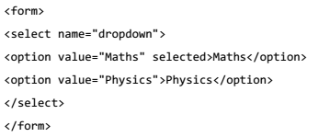
Select Box Control
A select box, also called drop down box which provides option to list down various options in the form of drop down list, from where a user can select one or more options.

Slide 131
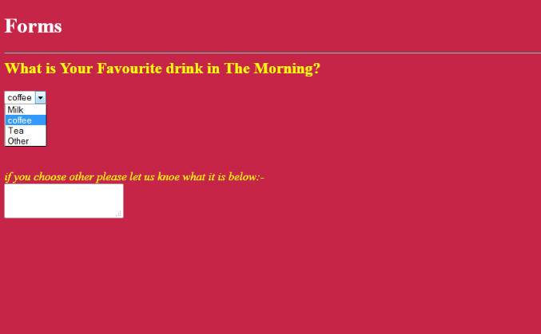
Exercise

Slide 132

Summery Exercise
Notes:
use #C52546 for background color and &nbsp; for space b/n elements other than <br> and if you use lists make the type none;

